Slide 1
MedNet Website
Jerry Britto J
Notes:
Start

Slide 2
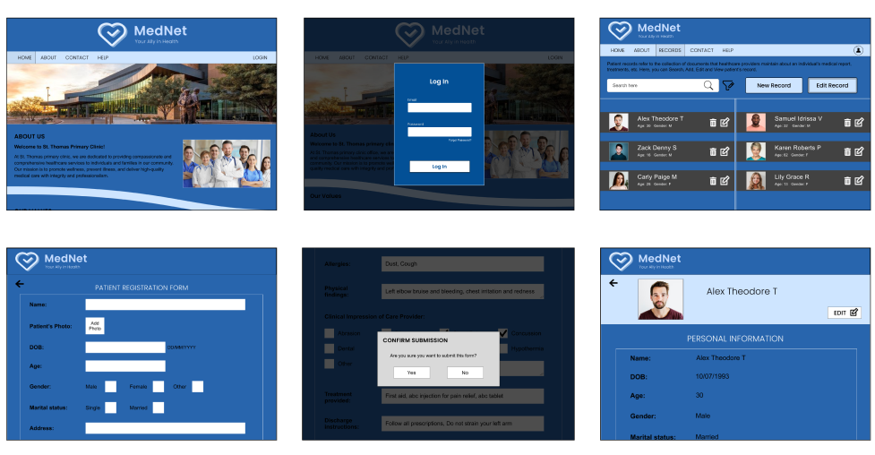
Project overview
The product:
The MedNet website is designed to streamline patient record management for healthcare professionals. With intuitive features, it empowers doctors and nurses to efficiently Create, Edit, View, Download and Print the patient records, Accessible from anywhere at anytime ensuring accurate information for enhanced patient care.
Project duration:
Jan 2024 to Feb 2024

Slide 3
Project overview
The problem:
Difficult to create, maintain and retrieve records in traditional method (paper format). Takes a lot of time and effort to record and access patient’s information from various departments at different time.
The goal:
To provide a digital method (website) to make the process of recording patient’s information more easier, efficient, and accessible at any time for healthcare professionals.

Slide 4
Project overview
My role:
UX Researcher, UX Designer, UX Writer.
Responsibilities:
User research, Information architecture, Wireframing, Prototyping, Visual design.

Slide 5
User research
Personas
Problem statements
User journey maps
Understanding
the user

Slide 6
User research: summary
For the MedNet Website project, I conducted user research primarily focused on understanding the workflow and pain points of healthcare professionals involved in patient record management. User interviews helped me to identify these problems. Assumptions were made that users primarily sought efficiency, streamlined processes, easier and intuitive interfaces. However, after extensive research, I discovered that data accuracy, data integrity and accessibility were equally critical. Users expressed concerns about ease of navigation and the need for comprehensive record-keeping features. As a result, my assumptions evolved to prioritize not only efficiency but also data accessibility and integrity, leading to a more holistic approach in designing the MedNet app to meet the diverse needs of healthcare professionals.

Slide 7
User research: pain points
1
2
3
4
User-friendly UI
Easier Data entry
Data accessibility
Simple data retrieval
By emphasizing intuitive menu structures, clear labelling, and streamlined pathways to ensure seamless user interaction.
By prioritizing intuitive input forms, minimizing redundant fields, and providing more input fields to enter various information to streamline the entry process.
By incorporating efficient search functionalities, customizable filters, and a user-friendly dashboard layout to ensure swift and seamless retrieval of patient records
By prioritizing seamless integration with cloud storage services, and simplified download processes to enable healthcare professionals to access and download patient records.

Slide 8
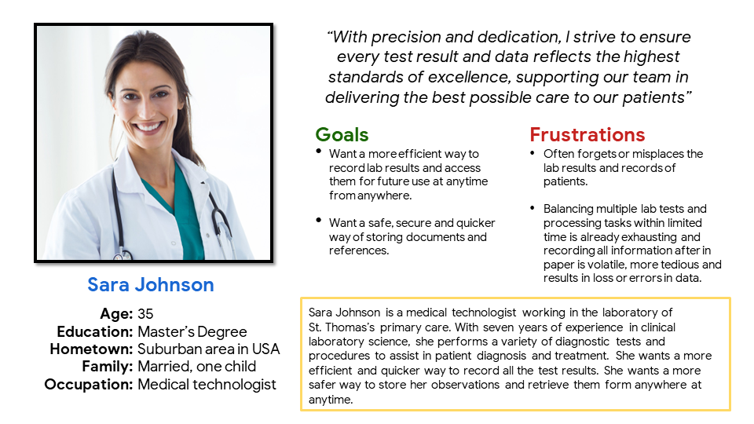
Persona: Sara Johnson
Problem statement:
Sara Johnson is a Medical technologist who needs a efficient and secure way to store and access lab results of patients becauseit is a tedious and exhausting work to retrieve them physically whenever required.

Slide 9
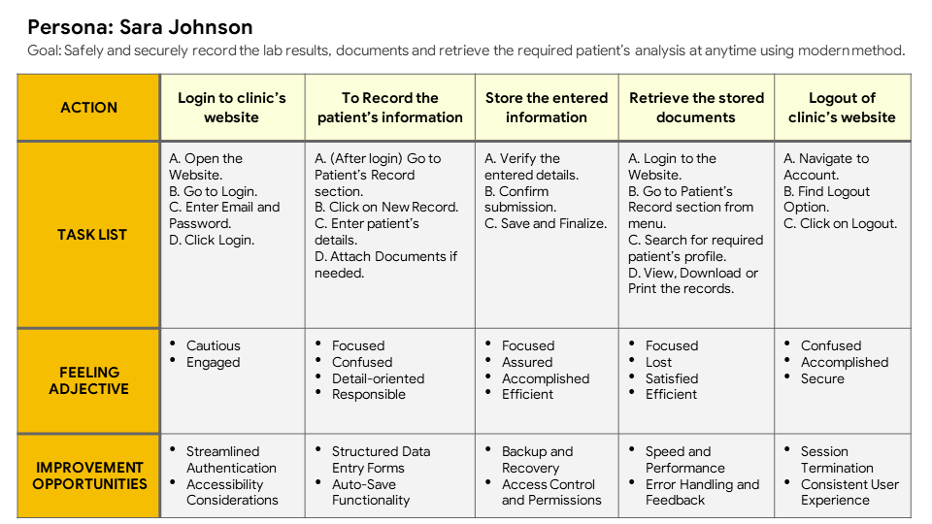
User journey map
User is navigating though the MedNet website to perform their task from login till logout. The navigation and interface must be clear, understandable and user-friendly and also provide the functions to complete the task which makes their journey more easier so that the user won’t be confused or frustrated.

Slide 10
Paper wireframes
Digital wireframes
Low-fidelity prototype
Usability studies
Starting
the design

Slide 11
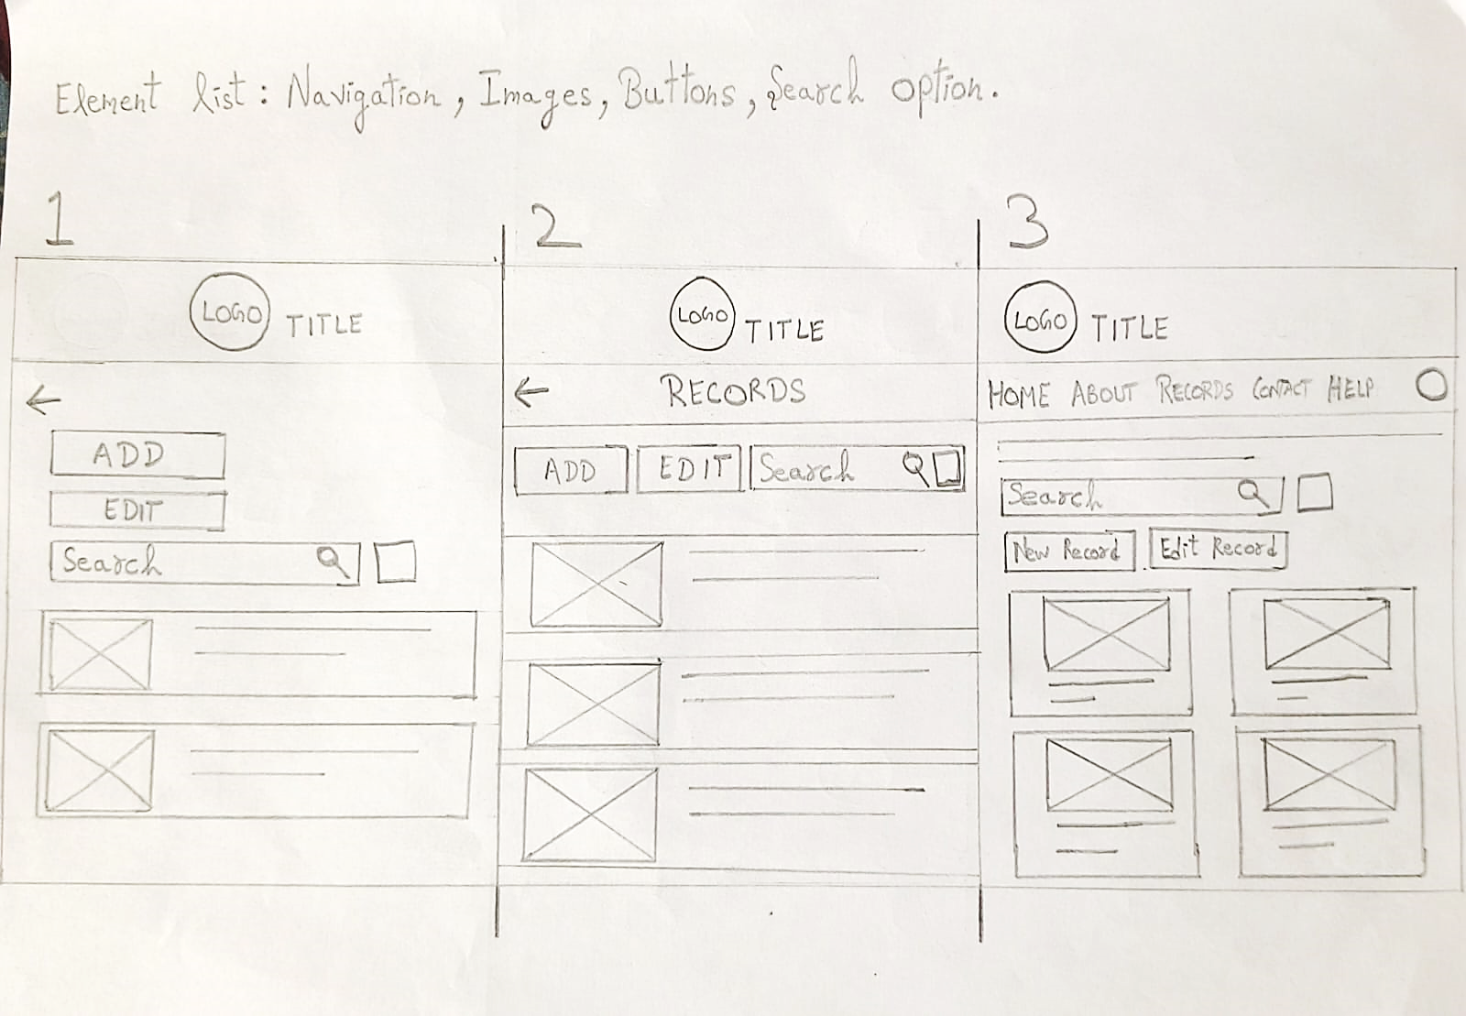
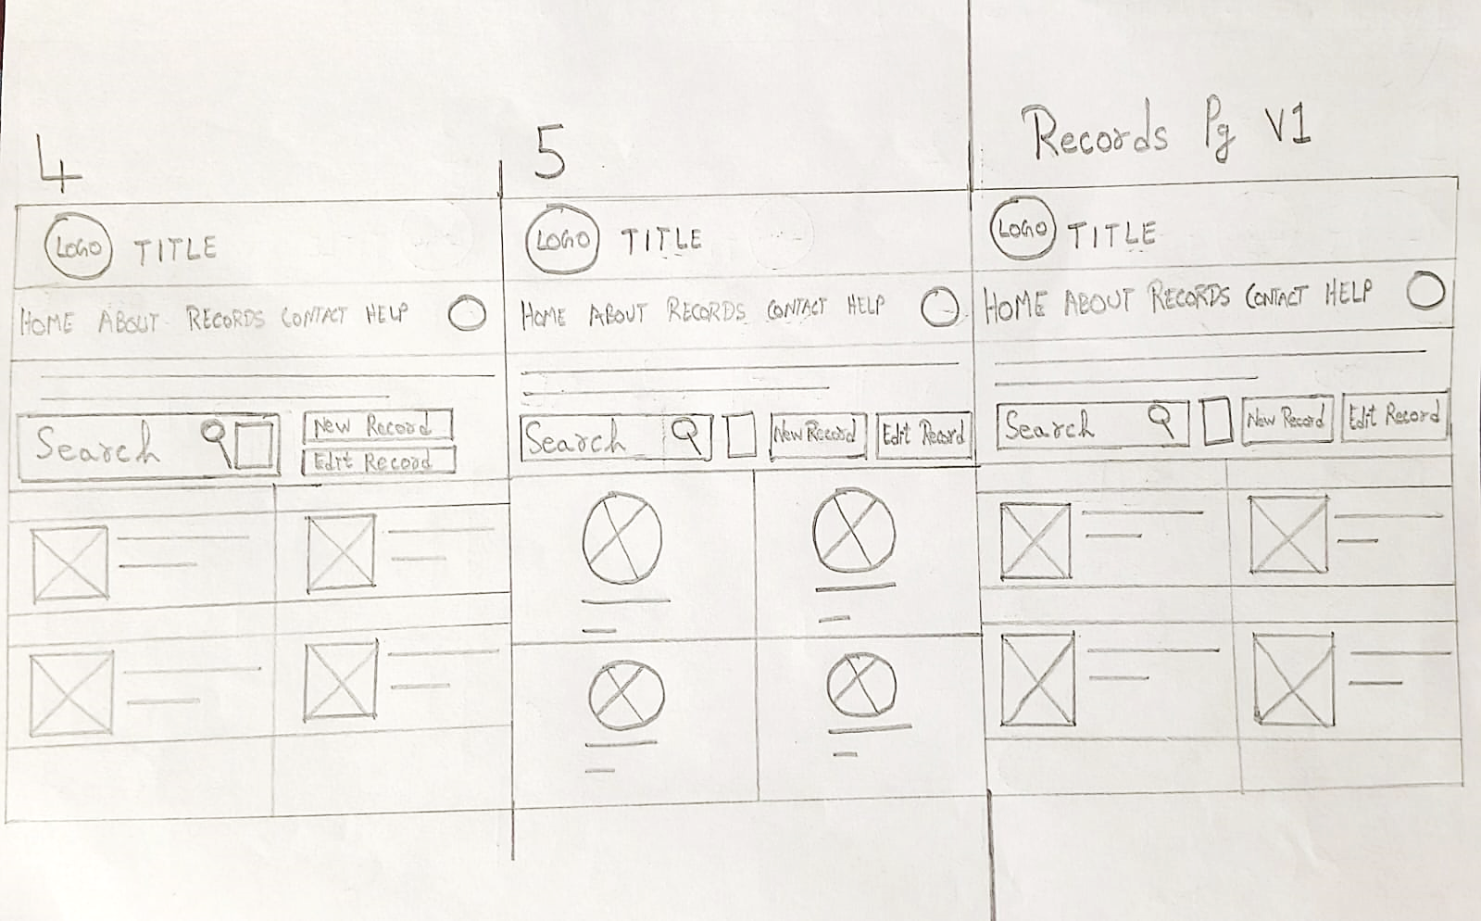
Paper wireframes
I took some time to draft my thoughts on how each screen of the website should look like on paper ensured that the elements that made it to digital wireframes would be useful to solve users pain points. For Patient Records screen, I prioritized easy navigation with search functions to quickly find and understandable patient records design to view, which saves users time and effort.
Stars were used to mark the elements of each sketch that would be used in the initial digital wireframes.

Slide 12
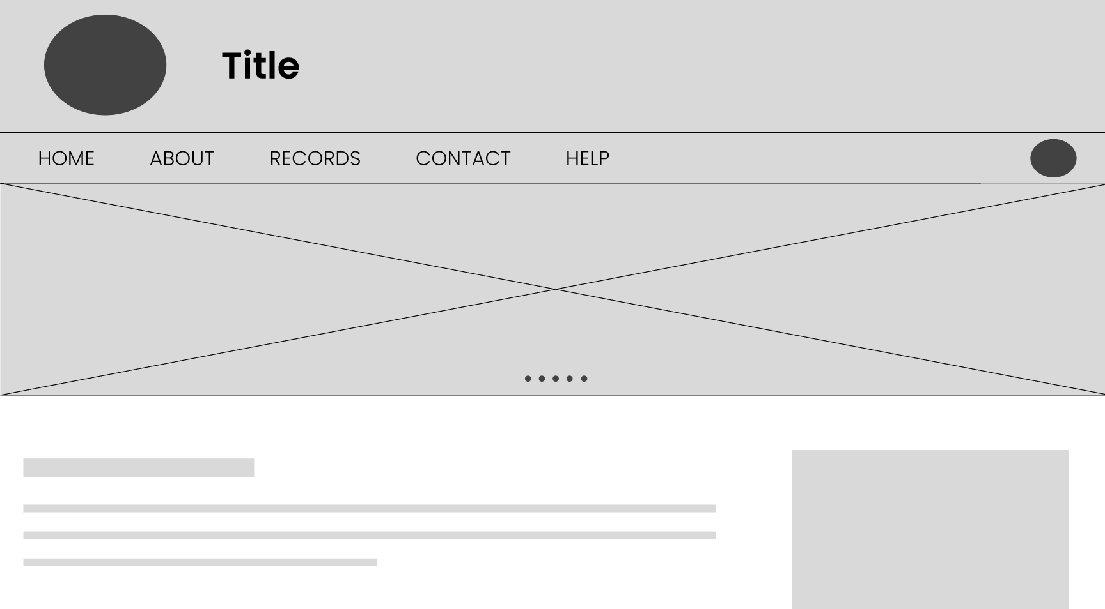
Digital wireframes
Easy navigation access to sections that’s user-friendly and screen reader
Easy navigation was a key user need to address in the designs in addition to equipping the website with assistive technologies.
Clear labels with to make it understandable and easier to identify.

Slide 13
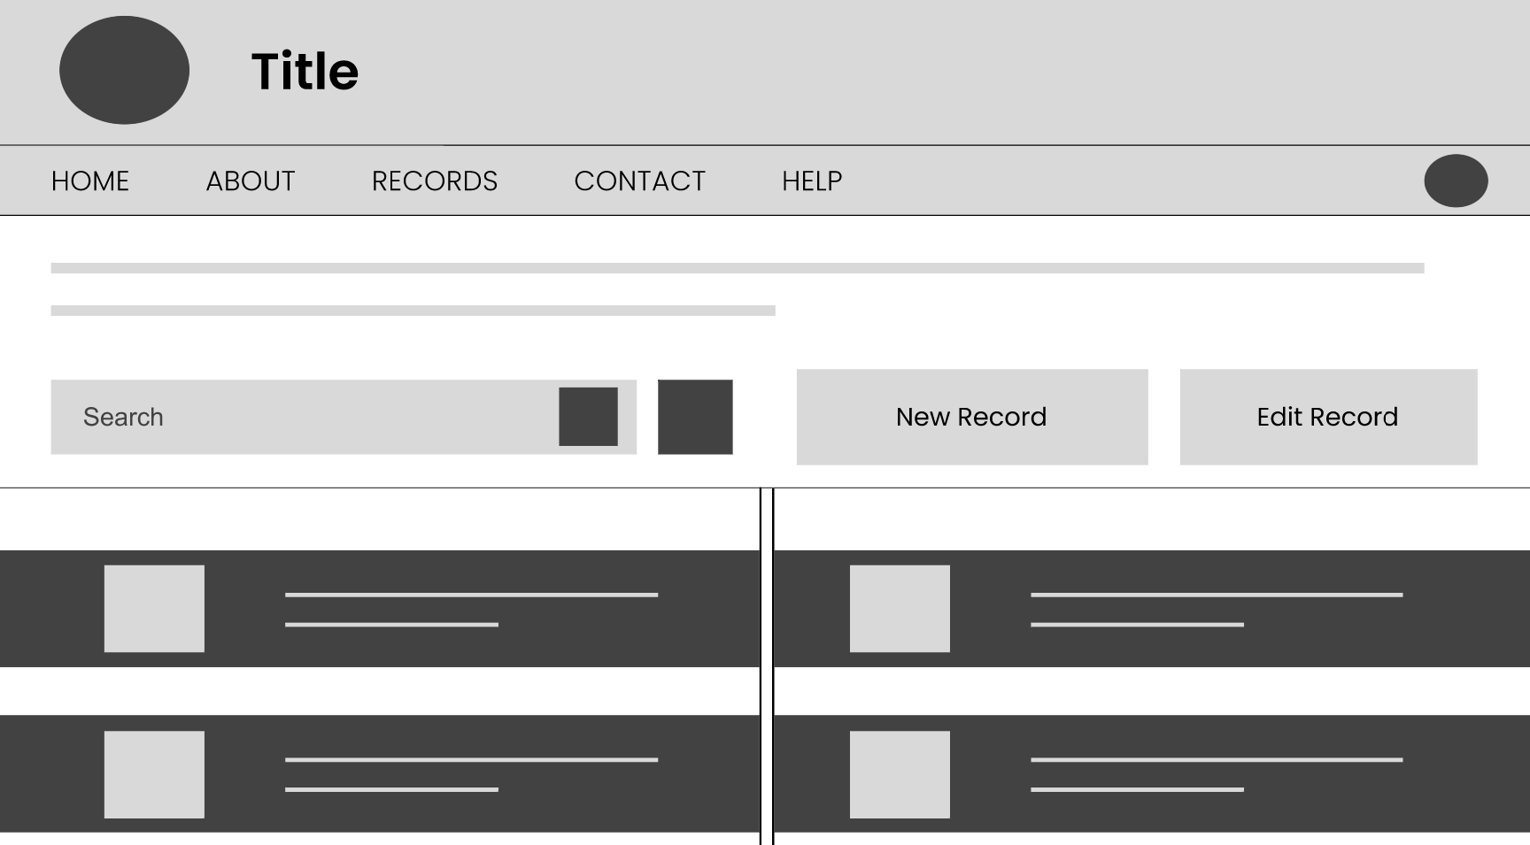
Digital wireframes
As the initial design phase continued, I made sure to base screen designs considering the user’s feedbacks, pain points and findings from the user research.
Advanced search and filter function to easily find specific records.
Intuitive profile design to make it more easier to navigate and identify records.

Slide 14
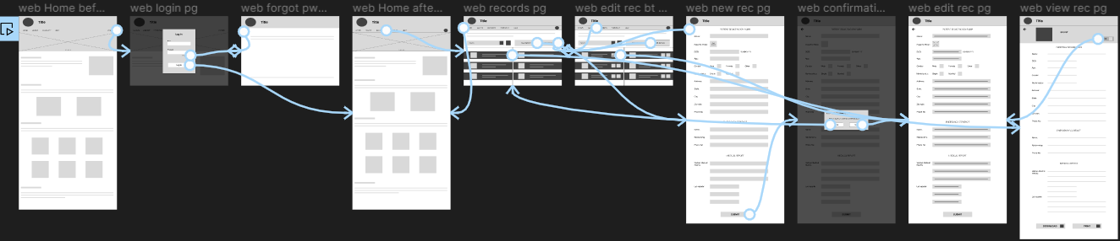
Low-fidelity prototype
The MedNet website starts off with the Home screen from there the user moves to Login page. After logging in it lands on the Home screen again. User navigates by clicking on different sections buttons provided. After clicking Patient Records section we see various buttons and patient records. The New record button helps users to create a new patient record. Edit button helps to edit information and also provides delete option. The Search and advanced filter options helps to identify specific records quickly and more easily. The user can simply click on patient’s record from Patient Records screen to View, Download or Print patient’s saved record. Finally we logout by clicking on either the Account icon from Home page or by going to the Account section from menu.
Link: https://www.figma.com/proto/0tjoGh2YV7qSjxCxsYyjl0/MedNet-Website?page-id=0%3A1&type=design&node-id=1-290&viewport=-459%2C335%2C0.14&t=O4KqniTkRyNQ93Pd-1&scaling=min-zoom&starting-point-node-id=1%3A290&mode=design

Slide 15
Usability study: findings
I have conducted moderated usability study for the MedNet website and I have learned that users have difficulty in some areas which will definitely be solved and improved before the final version using the findings from this study. The findings are listed below:
Round 1 findings
Round 2 findings
1
Users want appropriate icons
1
Users want a advanced filter option
2
Users want more input fields
2
Users want a auto-save function
3
Users want a Confirmation page
3
Users want a delete function

Slide 16
Refining
the design
Mockups
High-fidelity prototype
Accessibility

Slide 17
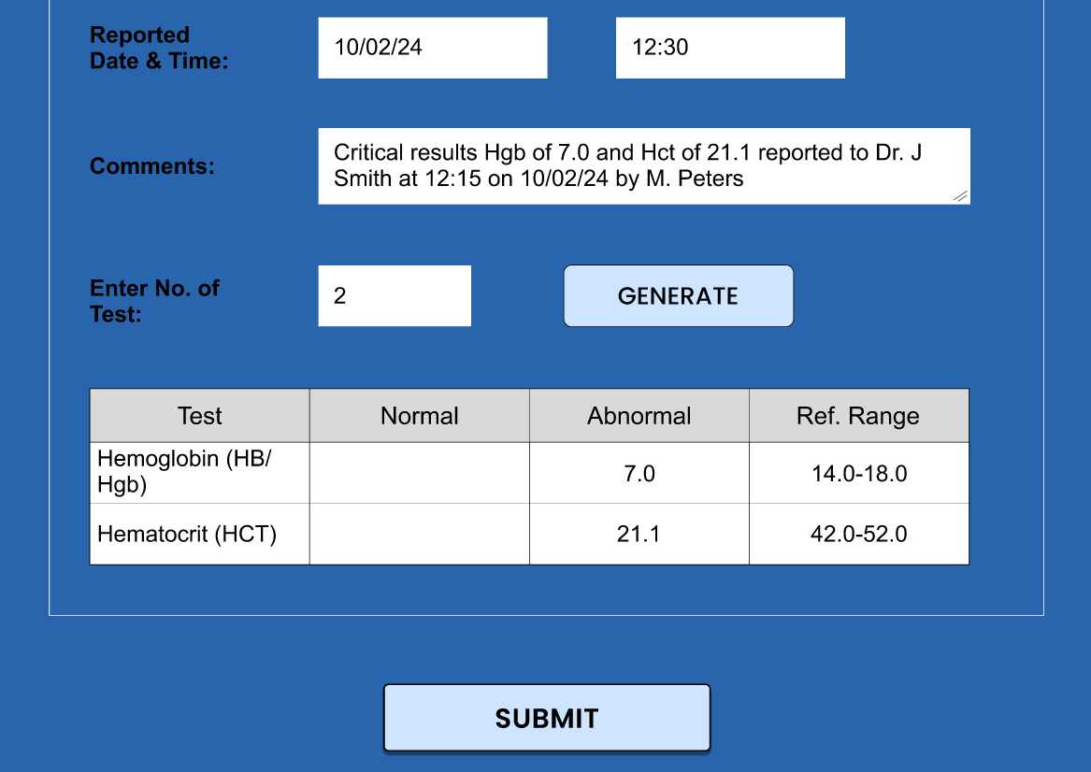
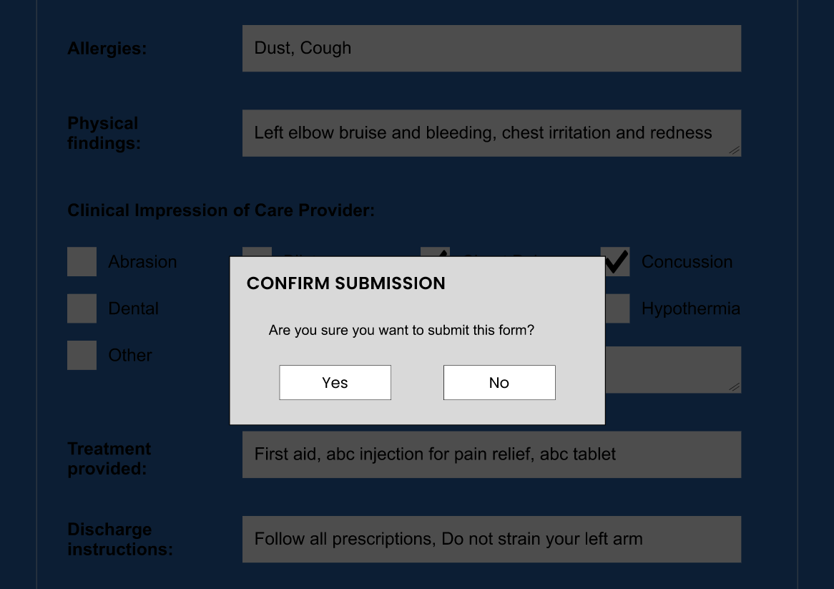
Mockups
Before usability study
After usability study
As the problem of needing a confirmation page and more input fields was mentioned as a pain point by the users I have decided to sort it out by adding the appropriate page and elements needed to solve the problem.

Slide 18
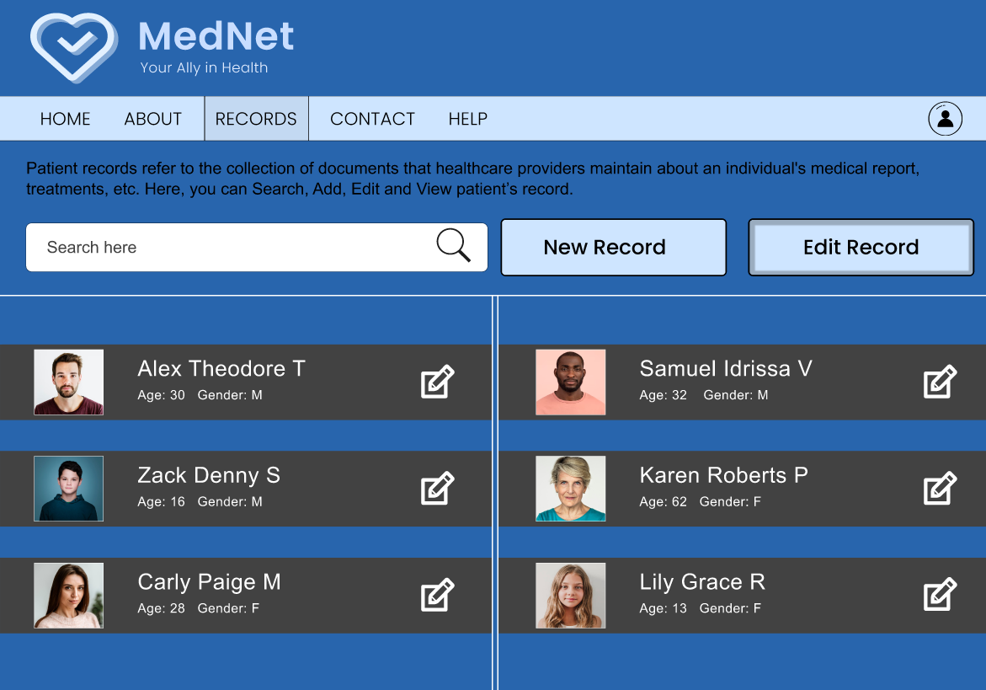
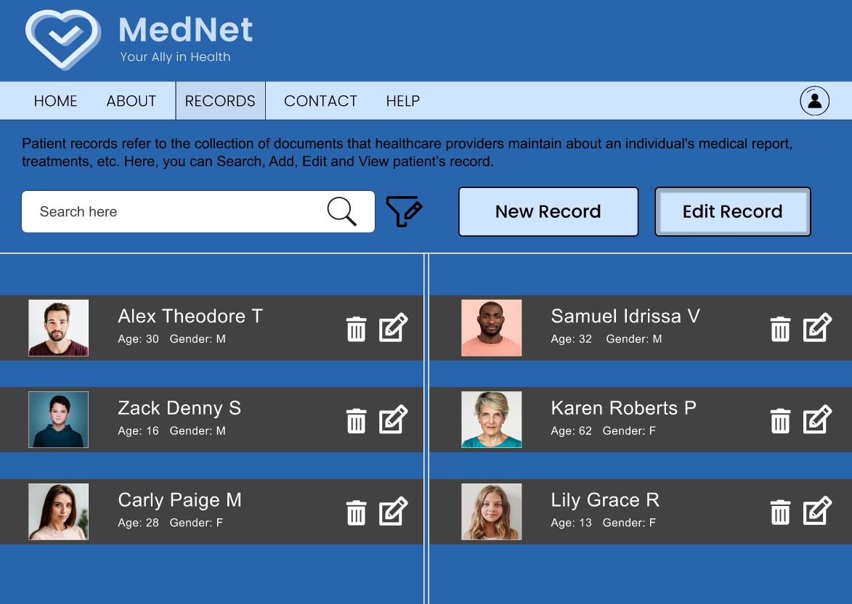
Mockups
Before usability study
After usability study
The users wanted advanced filter option and delete function so I have decided to added those features on the new mockup design to solve the user needs and make the website more easier to use.

Slide 19
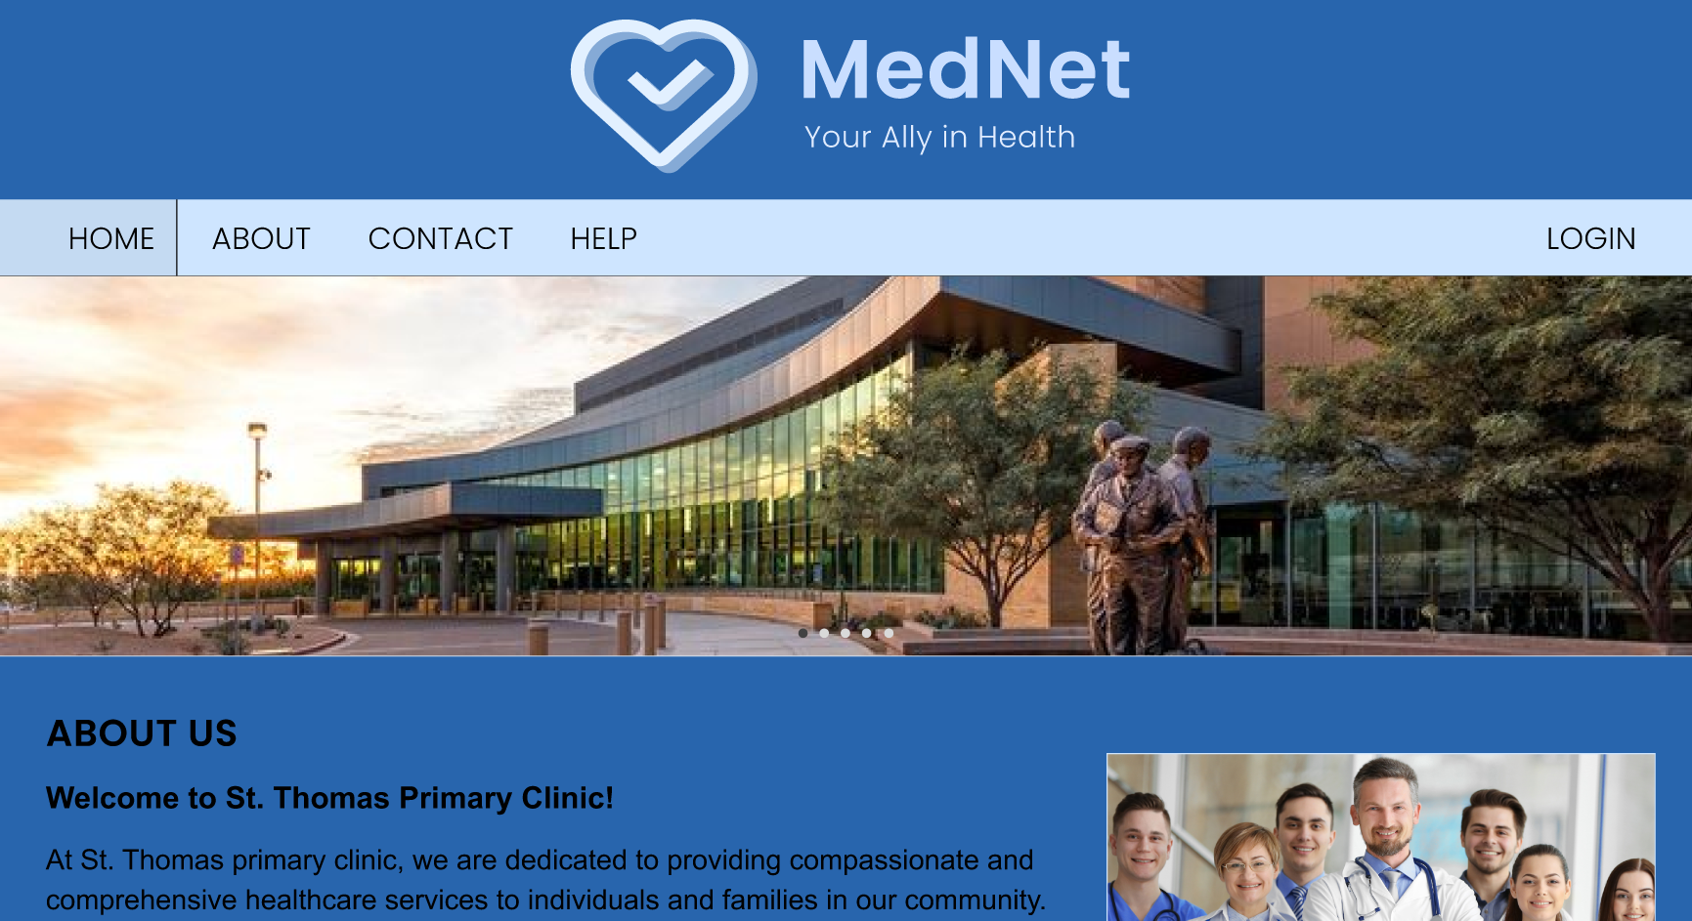
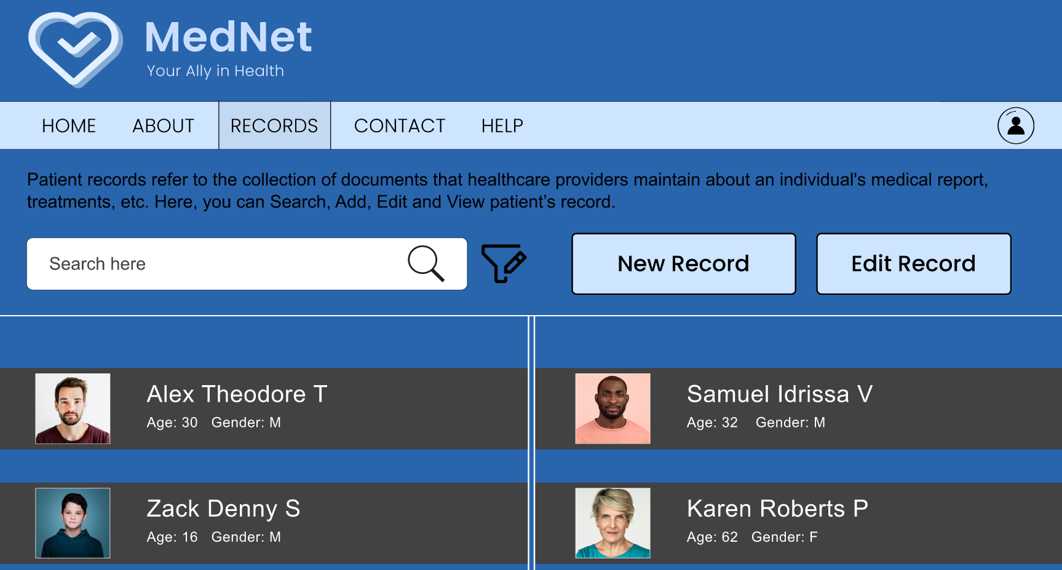
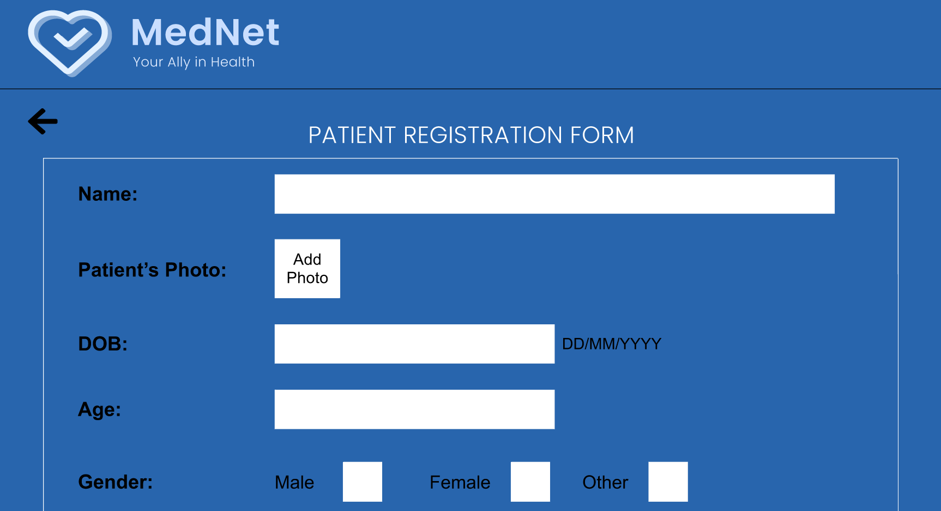
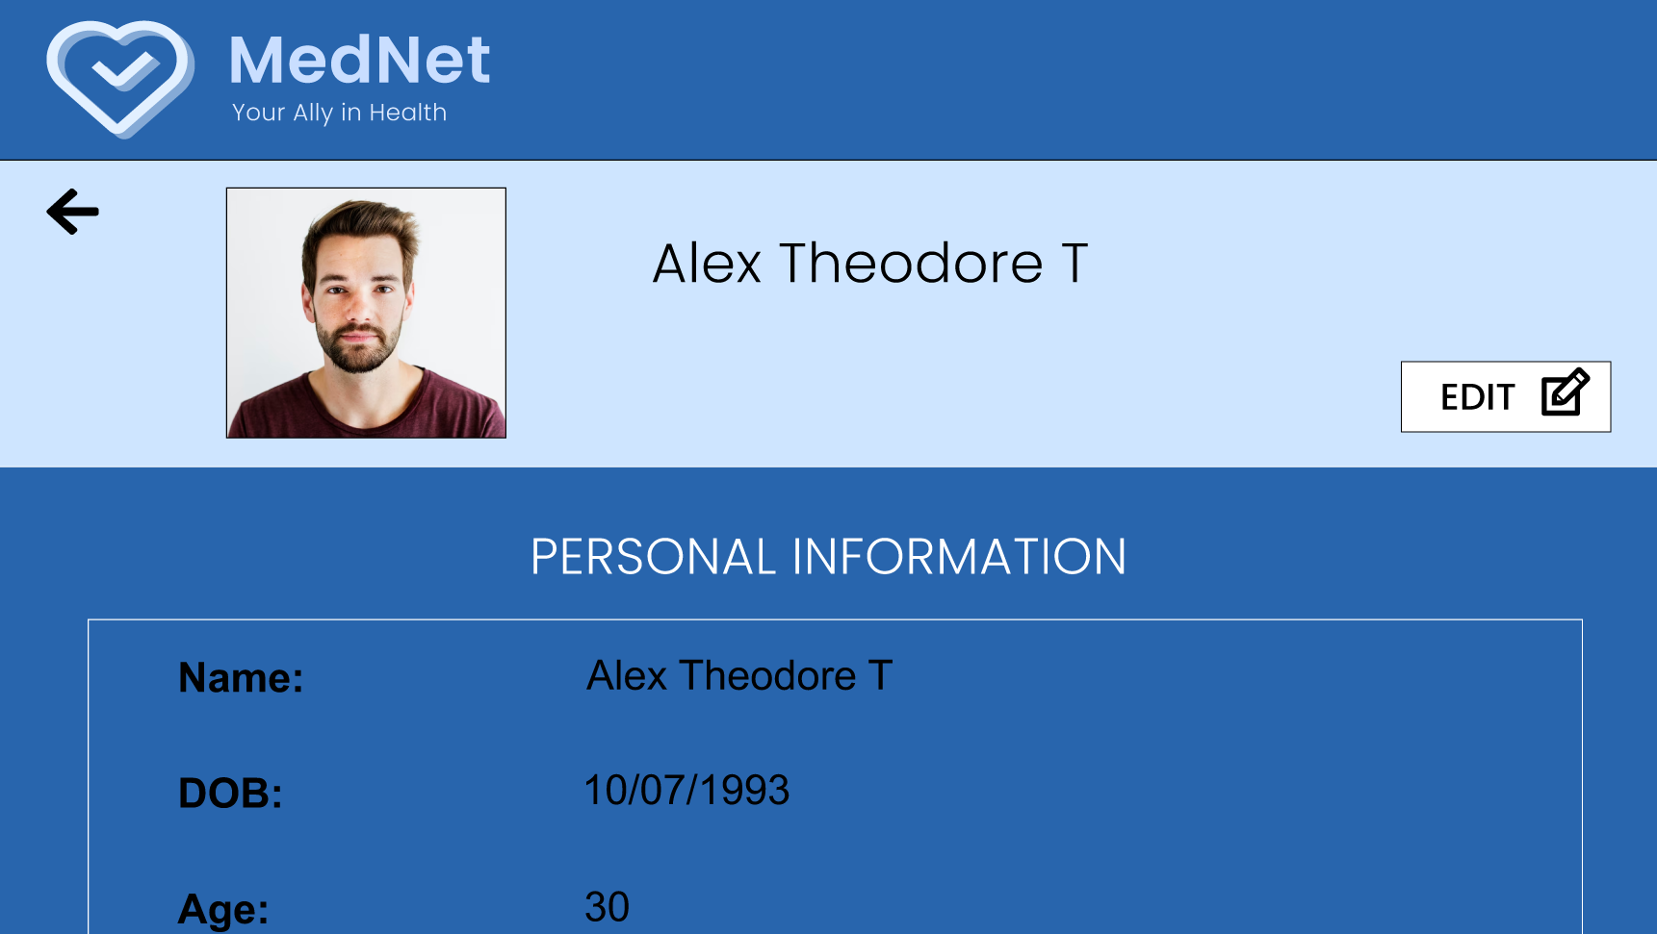
Mockups

Slide 20
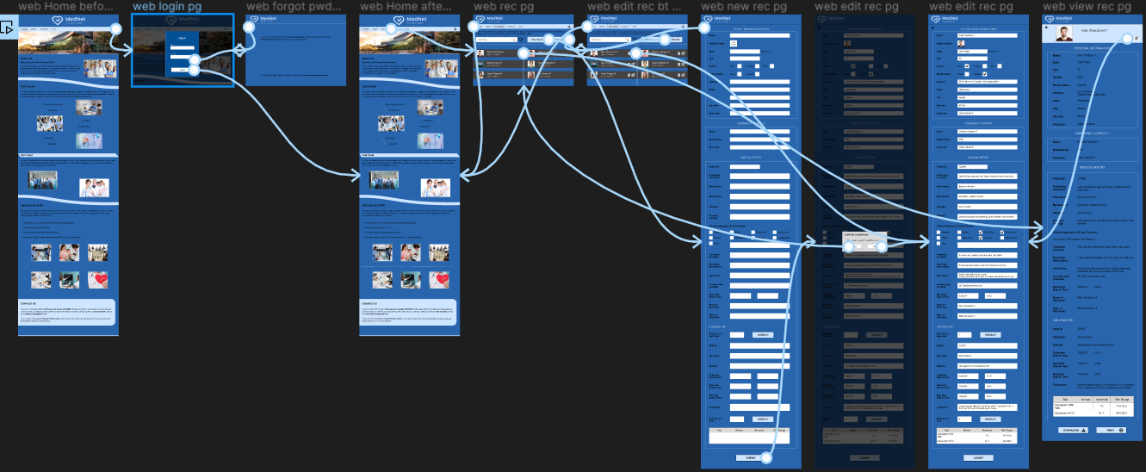
High-fidelity prototype
Link:
https://www.figma.com/proto/0tjoGh2YV7qSjxCxsYyjl0/MedNet-Website?page-id=1%3A2&type=design&node-id=1-427&viewport=-484%2C135%2C0.11&t=xr9vf262gkSzIy4c-1&scaling=scale-down&starting-point-node-id=1%3A427&mode=design

Slide 21
Accessibility considerations
1
2
3
Screen reader accessibility is meticulously implemented, allowing visually impaired users to navigate through menus, input fields, and buttons using their preferred screen reader software, fostering seamless interaction with the application.
The interface is designed with clear and consistent layout structures and contrast colours allowing users with cognitive disabilities to easily comprehend and navigate through the app, promoting an inclusive and user-friendly experience for healthcare professionals of diverse abilities.
It Incorporates auto-save feature which ensures that user input and changes to patient records are automatically saved at regular intervals, minimizing the risk of data loss. It promotes a seamless and efficient workflow for healthcare professionals, regardless of their accessibility needs or technical proficiency levels.

Slide 22
Going forward
Takeaways
Next steps

Slide 23
Takeaways
Impact:
Its intuitive features and seamless interface have saved both time and effort and have also covered modern methods of quicker and safer process of handling data.
Easily understandable UI and various other functions provided, helps the process of completing the tasks much easier.
What I learned:
Prioritizing users problems and their needs is the key to creating a successful and meaningful project.
I have learned the functionalities of figma to create designs for both apps and websites and have also learnt how to organize, visual design etc. to make the design of the website more aesthetically good, efficient, easy-to-use and accessible to the users.

Slide 24
Next steps
1
2
3
I am planning to add more features which would make the process of storing and accessing data more easier and quicker for the healthcare professionals.
Improving data security and integrity making the app more secure and robust ensuring data protection.
Improving the app’s performance and fixing bugs by prioritizing the feedbacks of the users and solving their problems thereby improving the overall user experience.

Slide 25
Let’s connect!
Contact Me:
Email - jerrybrit3@gmail.com
Linkedin - Jerry Britto | LinkedIn
You can check out my projects at:
Github - https://github.com/JerryBritto3

Slide 26
Thank you!

